Slide 1
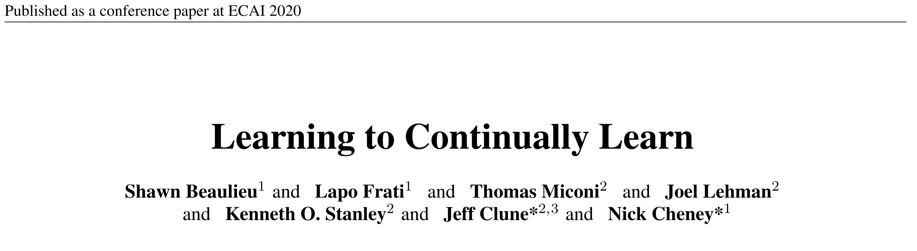
arXiv:2002.09571v2 [cs.LG] 4 Mar 2020

Slide 2
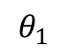
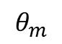
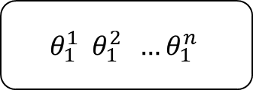
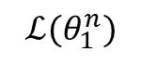
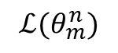
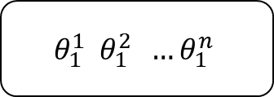

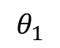
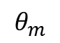
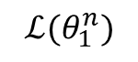
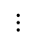
Meta-Training
Meta-Testing
Meta-Training Training
Meta-Training Testing
Meta-Testing Training
Meta-Testing Testing
$$θ_{1}^{1} θ_{1}^{2} …θ_{1}^{n}$$
$$θ_{1}^{1} θ_{1}^{2} …θ_{1}^{n}$$
$$θ_{1}$$
$${ℒ(θ}_{1}^{n})$$
$$θ_{m}$$
$${ℒ(θ}_{m}^{n})$$
$$θ_{1}^{1} θ_{1}^{2} …θ_{1}^{n}$$
$$θ_{1}$$
$${ℒ(θ}_{1}^{n})$$
$$⋮$$
$$θ_{m}$$

Slide 3
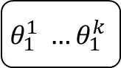


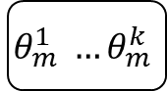



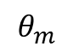

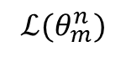

Meta-Training
Meta-Testing
Meta-Training Training
Meta-Training Testing
Meta-Testing Training
Meta-Testing Testing
task
task
task
task
$$θ_{1}$$
$$θ_{1}^{1} …θ_{1}^{k}$$
$$…$$
$$θ_{1}^{1} …θ_{1}^{k}$$
$${ℒ(θ}_{1}^{n})$$
$$θ_{m}$$
$$θ_{m}^{1} …θ_{m}^{k}$$
$$…$$
$$θ_{m}^{1} …θ_{m}^{k}$$
$${ℒ(θ}_{m}^{n})$$
task
task
$$θ_{1}$$
$$θ_{1}^{1} …θ_{1}^{k}$$
$$…$$
$$θ_{1}^{1} …θ_{1}^{k}$$
$${ℒ(θ}_{1}^{n})$$
$$⋮$$
$$θ_{m}$$

Slide 4
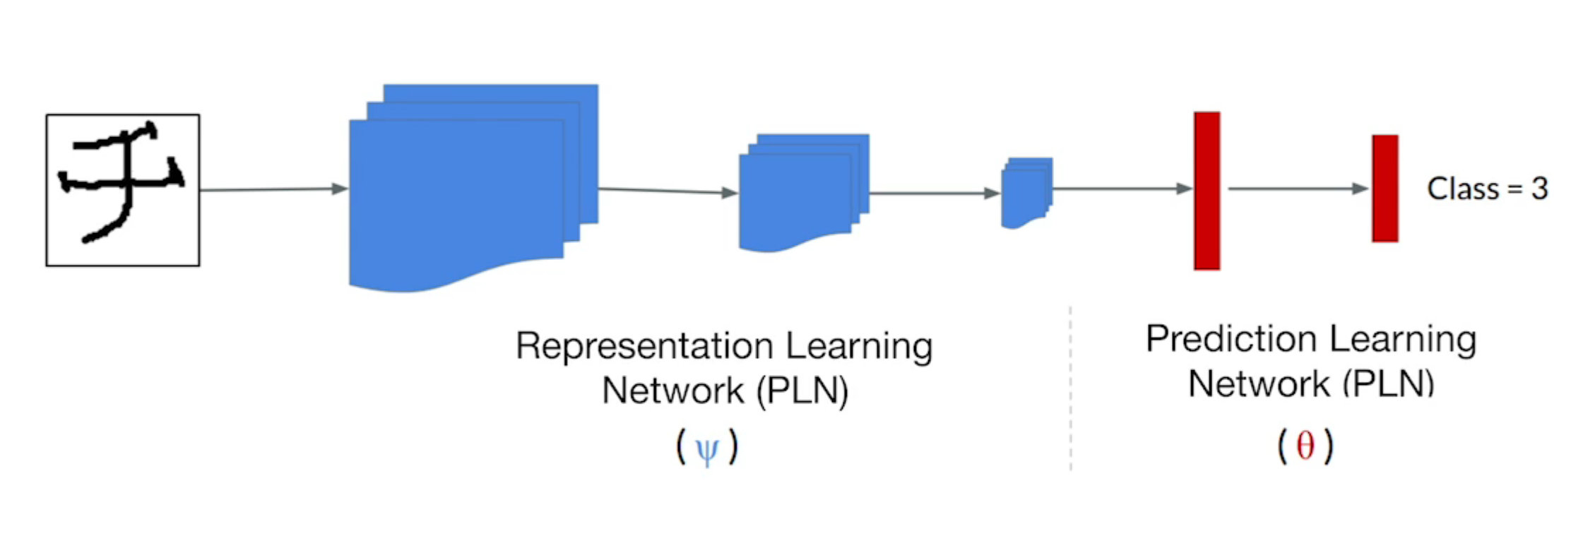
OML
Javed & White 2019

Slide 5
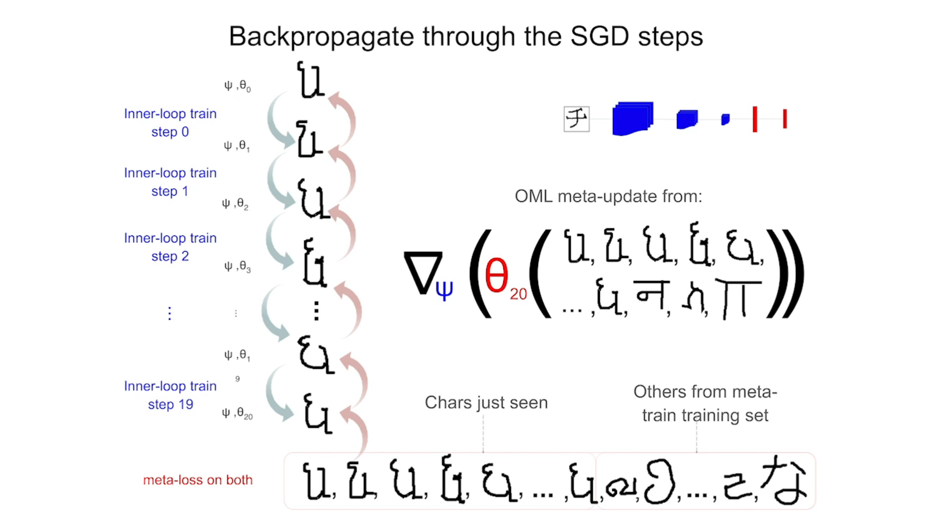

Slide 6
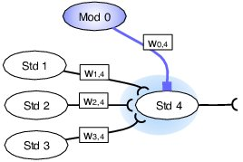
Traditional neuromodulation
Soltoggio et al. (2008)
Figure 2: Ovals represent standard and modulatory neurons labelled with Std and Mod. A modulatory neuron transmits a modulatory signal – represented as a coloured shade – that diffuses around the synapses of the target neuron. Modulation affects the update of the afferent weights $w_{1,4}$ , $w_{2,4}$ and $w_{3,4}$.

Slide 7

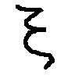
Overcompleteness
ANML has 7mil parameter
How many to classify all Omniglot ?
Sparse representation has its own power, but also has its cost : you need to be over complete
Yet we know its not enough

Slide 8
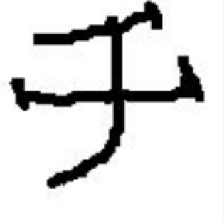

ANML
Neuromodulatory Network
Element-wise
multiplication
reshape
$$S$$
Prediction Network

Slide 9
Neuromodulation
Similar to Partial Softmax mentioned Monday, but controlled by a NN

Slide 10
Neuromodulation
Similar to Partial Softmax mentioned Monday, but controlled by a NN

Slide 12
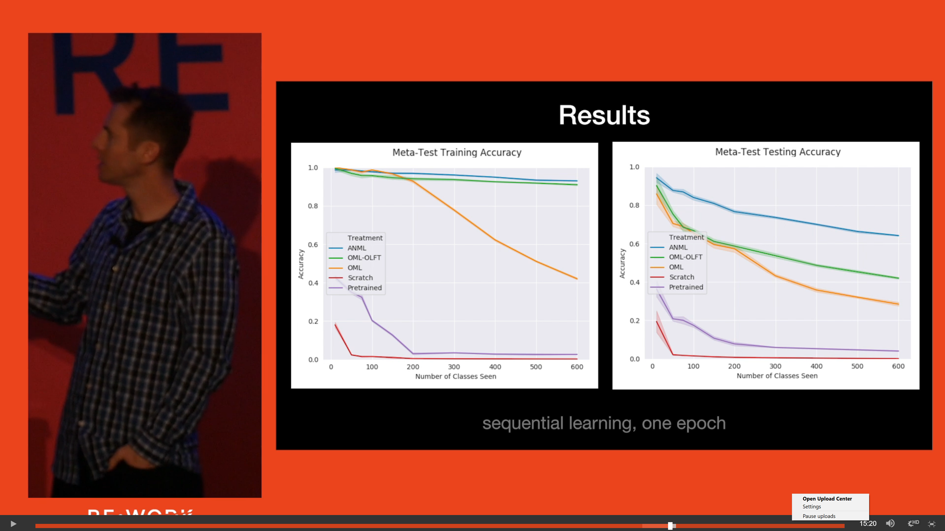
ANML Results

Slide 13
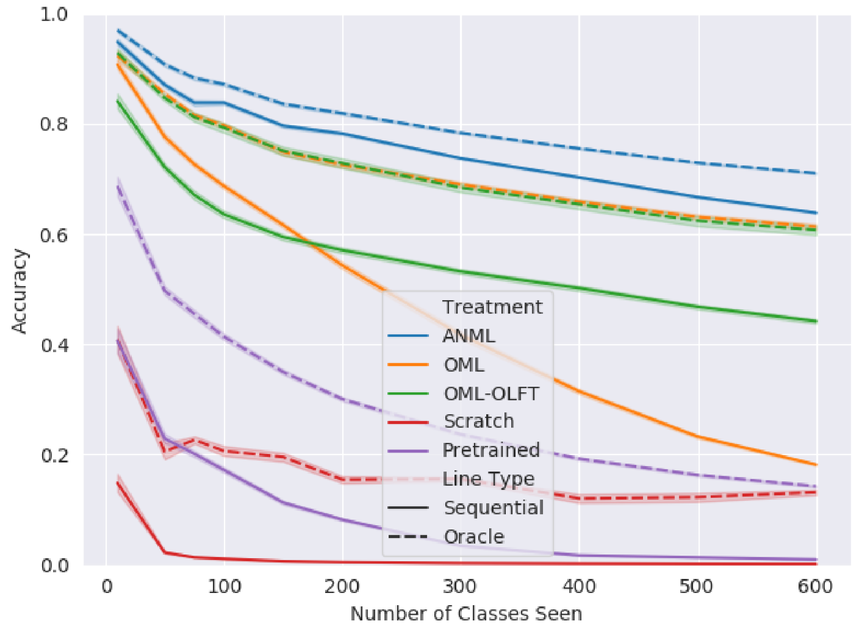
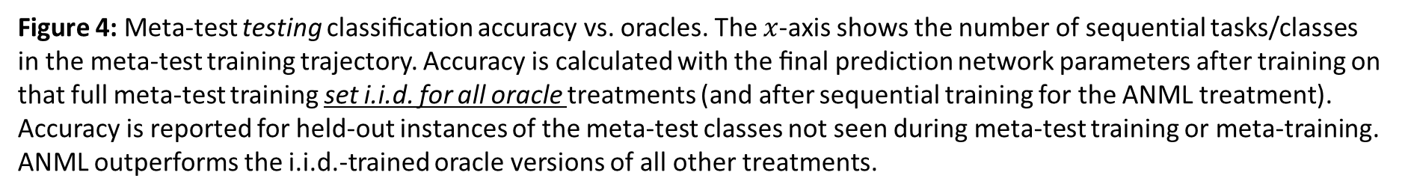
ANML Results
Figure 4: Meta-test testing classiﬁcation accuracy vs. oracles. The $x$-axis shows the number of sequential tasks/classes in the meta-test training trajectory. Accuracy is calculated with the ﬁnal prediction network parameters after training on that full meta-test training set i.i.d. for all oracle treatments (and after sequential training for the ANML treatment). Accuracy is reported for held-out instances of the meta-test classes not seen during meta-test training or meta-training. ANML outperforms the i.i.d.-trained oracle versions of all other treatments.

Slide 14
ANML Criticism
Task is class
Known number of classes in advance
Randomized List

Slide 15
ANML Criticism
Task is class
Known number of classes in advance
Randomized List

Slide 16
Equivalent ?
$$S$$
$$S$$
$$S$$
$$S$$
$$S$$
$$S$$
$$S$$

Slide 17

GLOBAL VS LOCAL ACCURACY

Slide 18
GLOBAL VS LOCAL ACCURACY

Slide 19
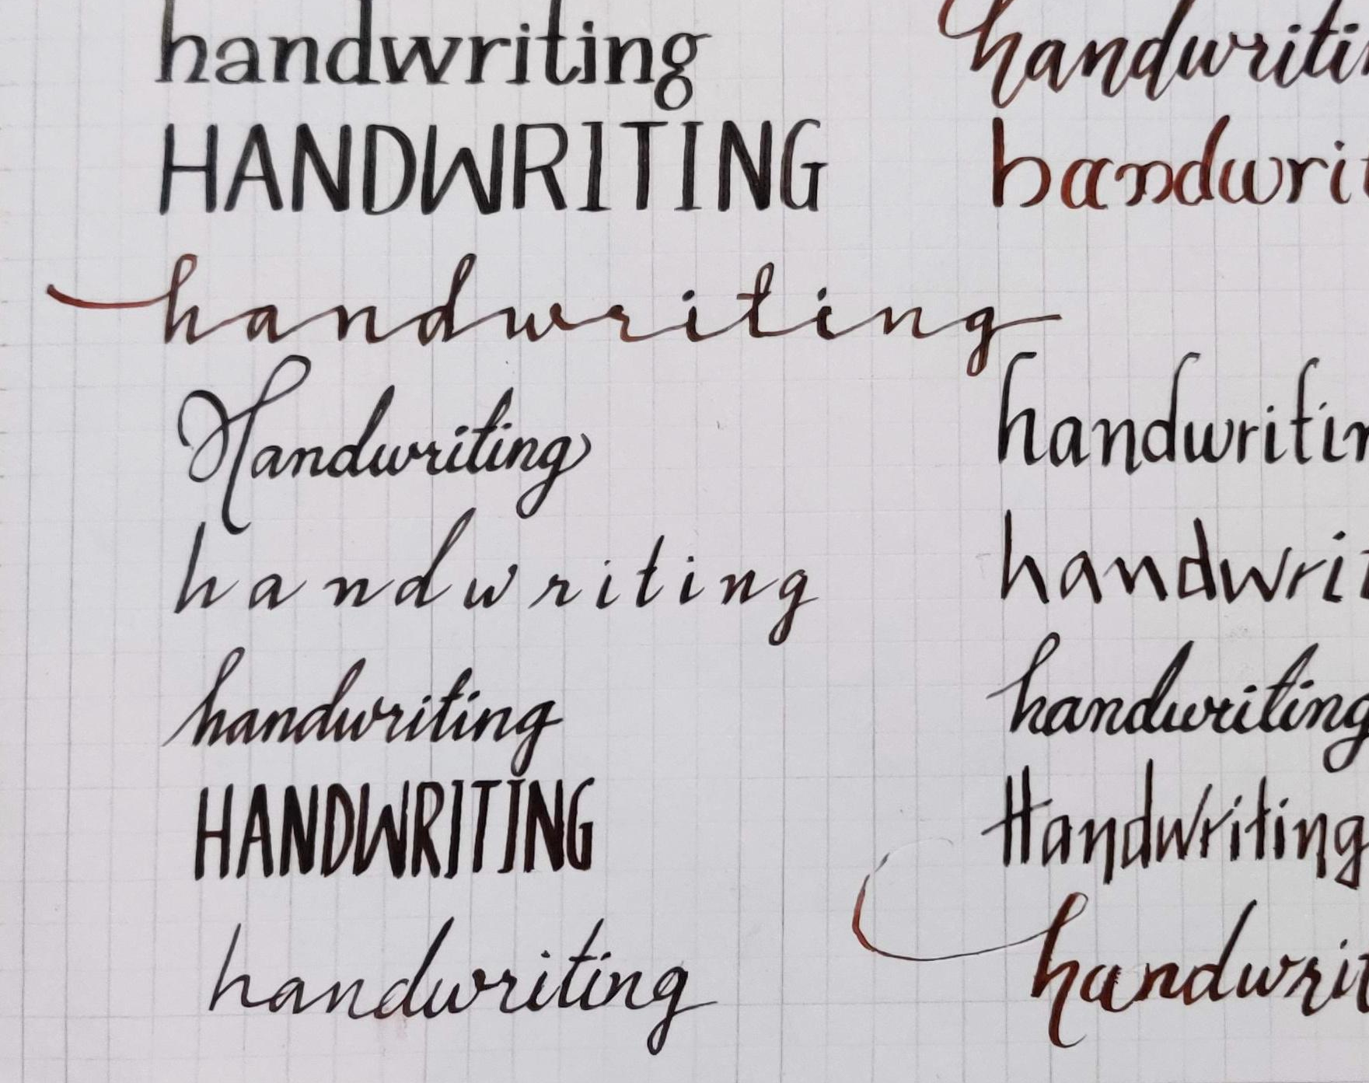
Marie’s Handwriting
Context matters
Unknown at test time
Learning order matters

Slide 20
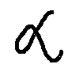
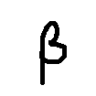
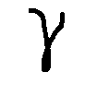
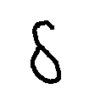
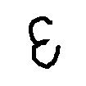

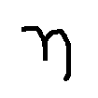
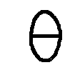
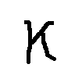
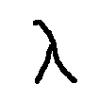
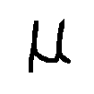
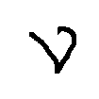
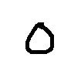
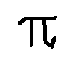
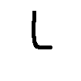
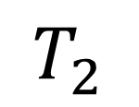
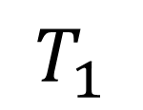
Handwritings
ANML_k8
$$T_{1}$$
$$T_{2}$$

Slide 21
Cellular Division in ANML
Distinction Network

Slide 22
Ideally plug context before the network
$$S$$
$$S$$
$$S$$
$$S$$

Slide 23
-Dynamic Neuromodulation
$$S$$
Ideally : Plug context before the network !
$$S$$
$$S$$
$$S$$
$$S$$
$$S$$

Slide 24
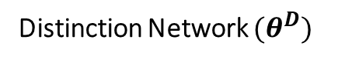
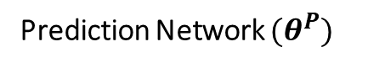
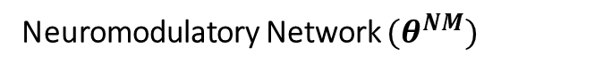
Neuromodulatory Network $(θ^{NM})$
Element-wise
multiplication
reshape
Prediction Network $(θ^{P})$
Distinction Network $(θ^{D})$

Slide 25
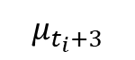
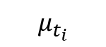
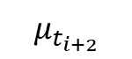
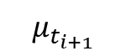
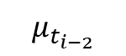
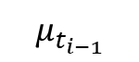
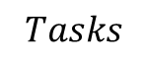
Soft Task Margin
$$μ_{t_{i−2}}$$
$$μ_{t_{i−1}}$$
$$μ_{t_{i}}$$
$$μ_{t_{i+1}}$$
$$μ_{t_{i+2}}$$
$$μ_{t_{i}+3}$$
$$Tasks$$

Slide 26
$$μ_{t_{i−2}}$$
$$μ_{t_{i−1}}$$
$$μ_{t_{i}}$$
$$μ_{t_{i+1}}$$
$$μ_{t_{i+2}}$$
$$μ_{t_{i}+3}$$
$$Tasks$$

Slide 27
Blurred distinctions

Slide 28

Context detection is the most important task

Slide 29






$$μ_{t_{i−2}}$$
$$μ_{t_{i−1}}$$
$$μ_{t_{i}}$$
$$μ_{t_{i+1}}$$
$$μ_{t_{i+2}}$$
$$μ_{t_{i}+3}$$
$$Tasks$$

Slide 30
reshape

Slide 31




Results
Meta-Training Testing
Meta-Testing Testing
ANML (paper)
$$−$$
$$\sim 63\%$$
ANML_k8
$$\sim 98\%$$
$$\sim 23\%$$

Slide 32

Results
Meta-Training Testing
Meta-Testing Testing
ANML (paper)
$$−$$
$$\sim 63\%$$
ANML_k8 (task oracle)
$$\sim 98\%$$
$$\sim 30\%$$

Slide 33


Results
Meta-Training Testing
Meta-Testing Testing
ANML (paper)
$$−$$
$$\sim 63\%$$
ANML_k8 (task oracle)
$$\sim 98\%$$
$$\sim 30\%$$
$$\sim 96\%$$
$\sim 30\%$ also $!$
ANML_k8 (window)

Slide 34
Sliding Gate Theory

Slide 35
reshape

Slide 36


Results
Meta-Training Testing
Meta-Testing Testing
ANML (paper)
$$−$$
$$\sim 63\%$$
ANML_k8
$$\sim 98\%$$
$$\sim 30\%$$
$$\sim 96\%$$
$\sim 30\%$ also $!$
ANML_k8 (window)
ANML (CL)
$$\sim 78\%$$
$$\sim 8\%$$

Slide 37


$$1$$
$$1$$
$$1$$
$$1$$
$$1$$
$$1$$
$$1$$
$$1$$
$$1$$
$$1$$
$$1$$
$$1$$
$$1$$
$$1$$
$$1$$
$$1$$
$$1$$
$$1$$
$$1$$
$$1$$
$$1$$
$$1$$
$$1$$
$$1$$

Slide 38
ANML
Neuromodulatory Network
Element-wise
multiplication
reshape
$$S$$
Prediction Network

Slide 39
$$1$$
$$1$$
$$1$$
$$1$$
$$1$$
$$1$$
$$1$$
$$1$$
$$1$$
$$1$$
$$1$$
$$1$$
$$1$$
$$1$$
$$1$$
$$1$$
$$1$$
$$1$$
$$1$$
$$1$$
$$1$$
$$1$$
$$1$$
$$1$$

Slide 41
Conclusion & Questions

